Slide 1
Activity Selection Problem

Slide 2
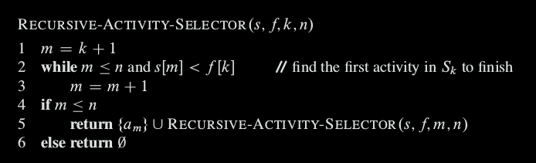
Recursive Greedy Algorithm
Initial call, which solves the entire problem, is RECURSIVE -ACTIVITY -S ELECTOR (s, f, 0, n)
Running time is θ(n)

Slide 3
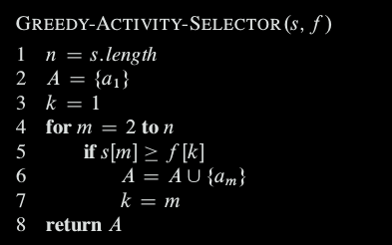
Iterative Greedy Algorithm
Initial call, which solves the entire problem, is GREEDY-ACTIVITY-S ELECTOR (s, f)
Running time is θ(n)

